Slide 1



GovHack 2016
Unleashed South Australia
Project: What are you afraid of?
Team: GovHackThePlanet

Slide 2
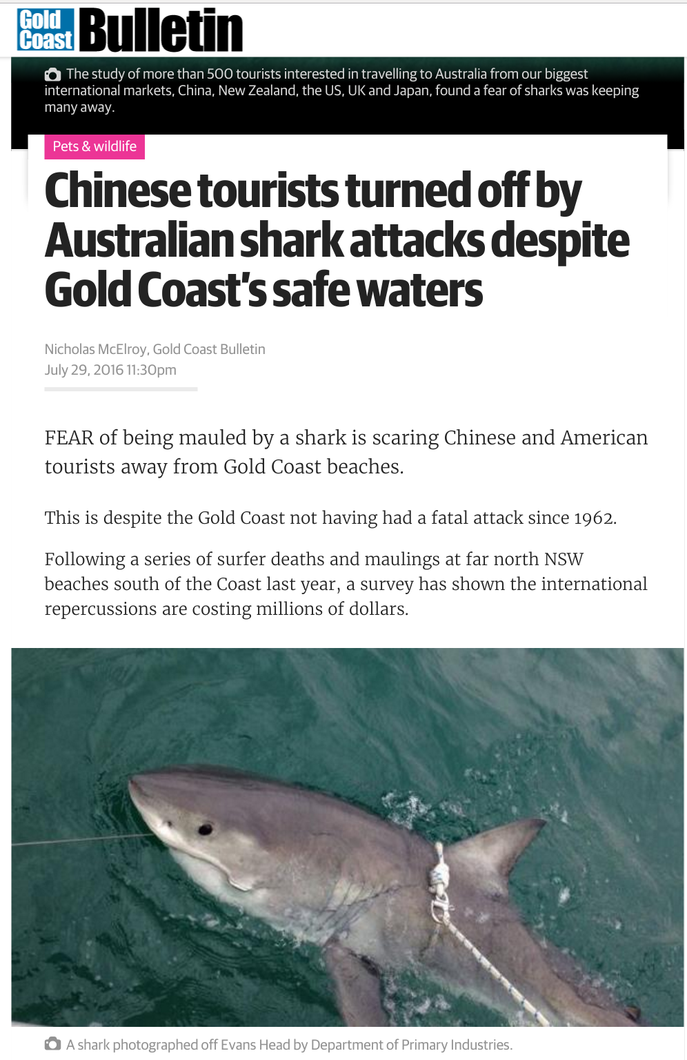

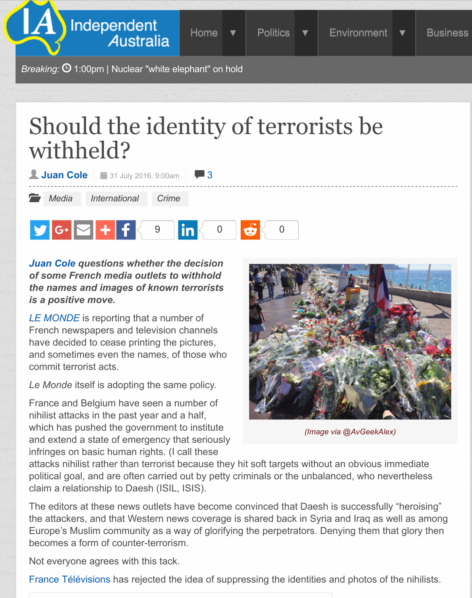
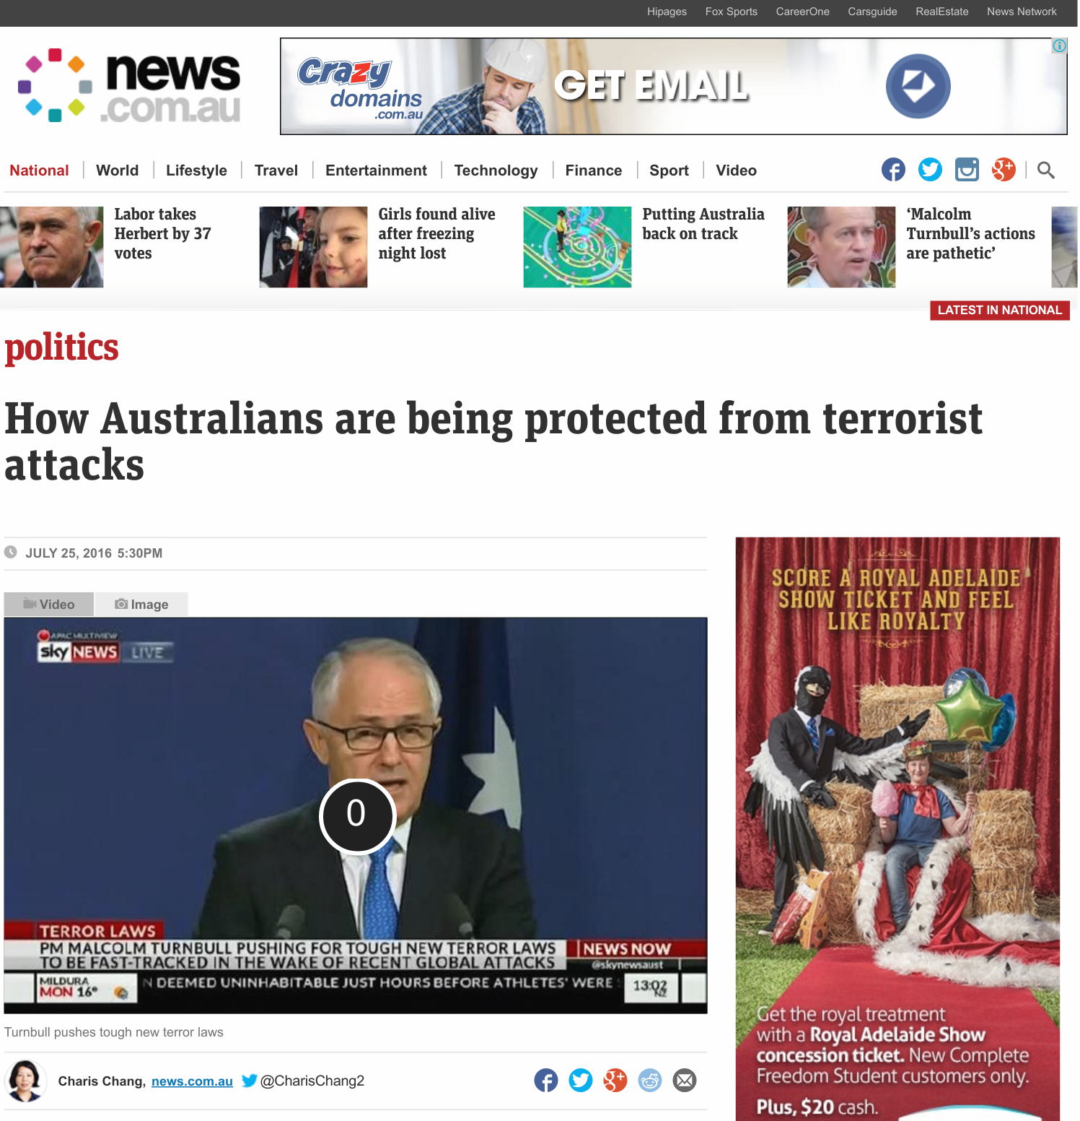


Slide 3


Combined fatal shark attacks and
terrorist attacks in Australia:
~ 2 per year (Australia)
Wikipedia
Combined deaths from diabetes, liver disease, hypertension, heart diseases:
~ 35,000 deaths per year (AU)
Australian Institute of Health and Welfare

